Slide 1

`

Slide 2
Core Competencies
Acknowledges mothers’ concerns about their ability to breastfeed.
Provides accurate and relevant information to mothers and their families about breastfeeding and emphasizes that most mothers can breastfeed.
Discusses appropriate solutions to common breastfeeding barriers and provides support and/or referrals as needed.

Slide 3
Learning Objectives
Identify common myths and misperceptions about breastfeeding.
Name strategies that address barriers pregnant or breastfeeding women feel will hinder them from initiating or continuing breastfeeding.

Slide 4

How Behavior Decisions Are Made: The Exchange Theory
Benefits
Costs

Slide 5

Barriers to Breastfeeding: Know Your Weeds!
“I know breastfeeding is best for my baby, but…”
“I’ve heard it…”
“If I do that I won’t be able to...”
“My mom said…”
“My partner said…”

Slide 6
Weed Prevention and Control
Best way to identify barriers: Listen to mothers
Commonly mentioned barriers:
Confidence regarding milk production
Time and social constraints
Embarrassment
Lack of support (Dad, Grandmothers)
Fear of pain
Help mothers identify solutions that work for her

Slide 7
Embarrassment
Concern when in public or family is present
Fear of exposure; lack of privacy
Shaped by social norms
Difficult for some to discuss
Some may want to keep breastfeeding secret
“You’d have to do what you have to do in front of everybody
and it would just be strange I think.”
-WIC Mother, discussing breastfeeding in a focus group

Slide 8
Time and Social Constraints
How can I fit breastfeeding into my busy life?
Many assume they cannot breastfeed if they go back to work.
Many unaware they can express their milk.

Slide 9

Lack of Social Support
Key support people:
Grandmothers
Baby’s father
Influence:
Decisions to try breastfeeding
Length of breastfeeding

Slide 10
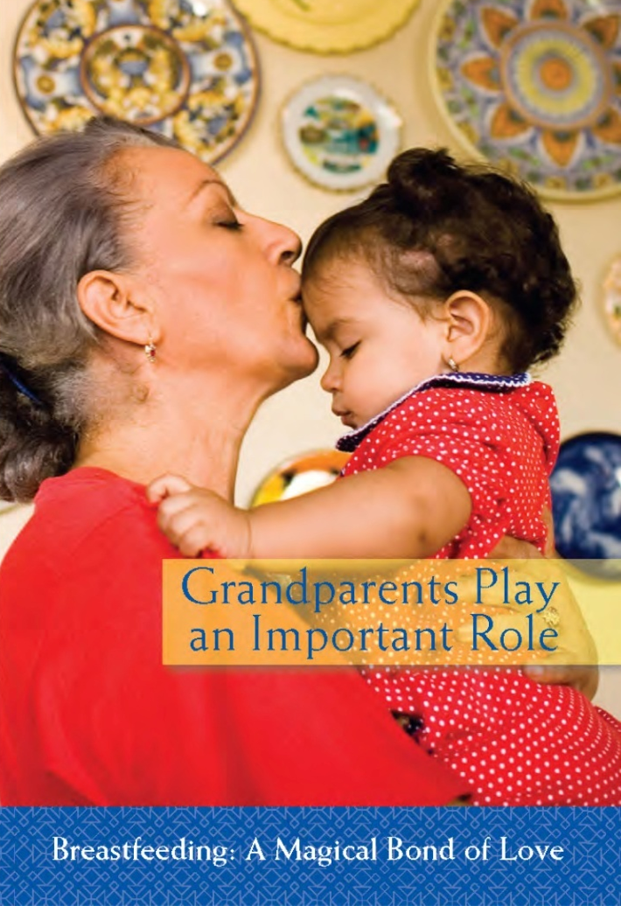
Grandmothers: Key to Success
Involve grandmothers in education
Be respectful
Emphasize grandmothers’ supporting role

Slide 11
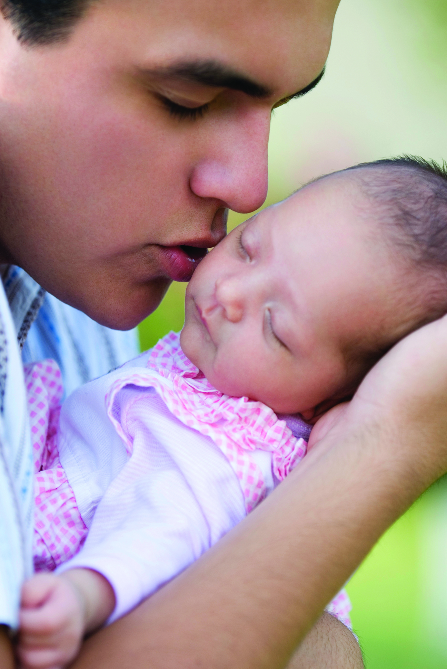
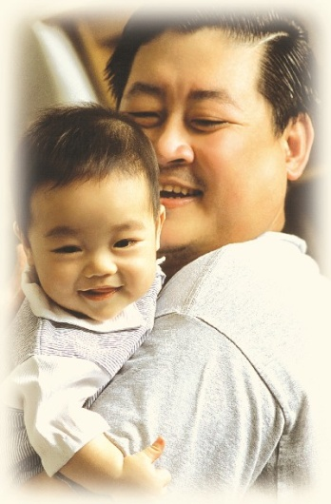
Dads Make a Difference
Mother may assume (incorrectly) dad won’t be supportive
Address father’s barriers
Display messages for dads in your clinic

Slide 12
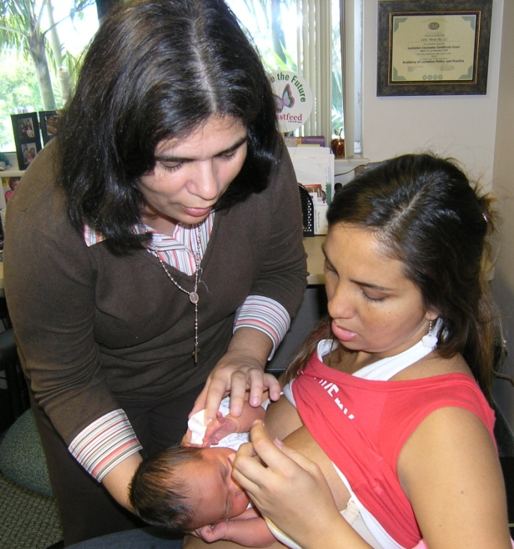
Fear of Pain
Should it hurt?
Help mothers know what to expect
Pain means they should call
Prepare them with contacts/resources during pregnancy
Miami Dade WIC

Slide 13

Concerns About Milk Production: Confidence
Underlies many barriers
Affirm concerns, what mother is doing well
Build confidence with anticipatory guidance
DVD: “To Baby, With Love: Overcoming Barriers to Breastfeeding” (Texas WIC State Agency)
Handout 4.1: “Weed Identification”

Slide 14
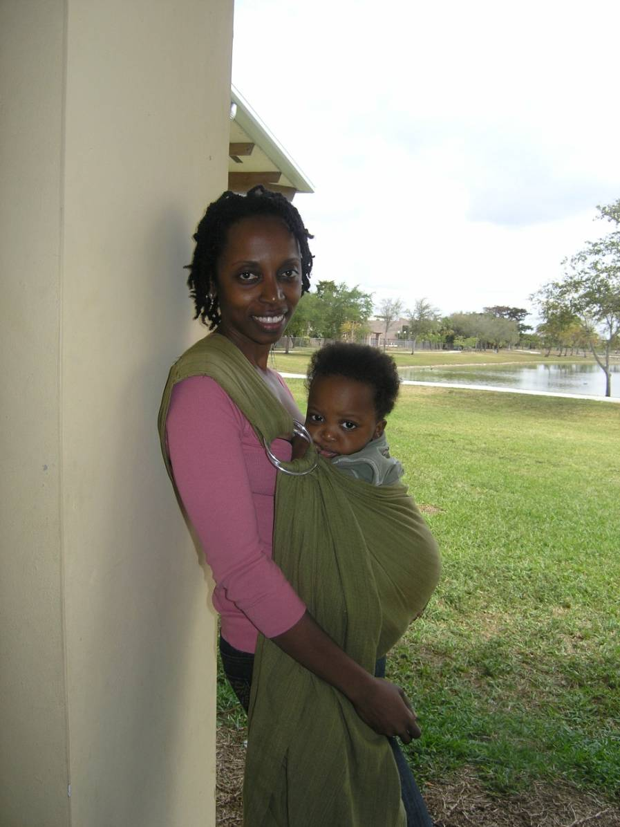
Talking with WIC Mothers About Barriers
Reassure mothers:
Many mothers encounter these issues
Identify strategies that work for her
Miami Dade WIC

Slide 15

Breastfeeding Myths

Slide 16
Who Can Breastfeed?
Mothers with small breasts?
Answer: Yes
Size depends on fatty tissue
Nearly every woman can make enough milk

Slide 17
Who Can Breastfeed?
Mothers who smoke cigarettes?
Answer: Yes
It is best for a mother not to smoke
Breastfeeding may help protect the baby
Educate her about smoking away from baby
May lower milk production

Slide 18
Who Can Breastfeed?
Mothers who are stressed out?
Answer: Yes
Hormones released during breastfeeding calm mother and baby
A mother’s milk will not “spoil” if she gets upset

Slide 19
Who Can Breastfeed?
Mothers with poor eating habits?
Answer: Yes
A mother will make good milk for her baby
Eating a balanced diet helps the mother recover
No foods to exclude other than alcohol

Slide 20
Who Can Breastfeed?
Mothers who are ill?
Answer: In most cases…(colds, flu, etc.)
Once mother is showing symptoms, baby has been exposed
Baby gets antibodies through his mother’s milk
Many medications compatible with breastfeeding
Only a few conditions where mothers should not breastfeed (e.g., HIV, tuberculosis, illegal drugs, etc.)

Slide 21
Who Can Breastfeed?
Mothers with implants/past breast surgery?
Answer: Maybe
Implants may make mother more prone to plugged ducts
Breast injury, biopsy, or reduction surgery requires a case-by-case assessment
Yield mother to the WIC Designated Breastfeeding Expert

Slide 22
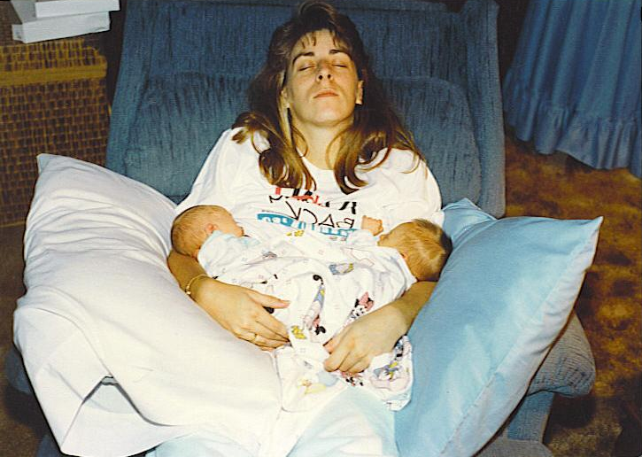
Who Can Breastfeed?
Mothers of multiples?
Answer: YES
Mothers of multiples can produce plenty of milk for their babies
(2100 ml v. 800 ml)
Yield to the WIC Designated Breastfeeding Expert

Slide 23
Who Can Breastfeed?
Teen Mothers?
Answer: Yes
Teen mothers often make plenty of milk
Address unique barriers teens have
Yield to the WIC Designated Breastfeeding Expert and to a Peer Counselor

Slide 24
Who Can Breastfeed?
Diabetic Mothers?
Answer: Yes
Breastfeeding is protective for her baby
Give mom extra support in the first few days to breastfeed often (mature milk may be delayed)
Yield to the WIC Nutritionist and Designated Breastfeeding Expert for follow-up

Slide 25
Who Can Breastfeed?
Mothers who are pregnant and breastfeeding an older child?
Answer: In Most Cases…
Many women can breastfeed while pregnant
Yield to doctor and WIC Designated Breastfeeding Expert

Slide 26
What about Alcohol?
The Dietary Guidelines for Americans recommends that breastfeeding mothers not consume alcohol.
AAP states:
Breastfeeding mothers should avoid alcohol
Alcohol is concentrated in breast milk
Alcohol can inhibit milk production
An occasional single, small celebratory drink is okay, but breastfeeding should be avoided for 2 hours after the drink
Mothers should discuss alcohol consumption with their health care providers.

Slide 27
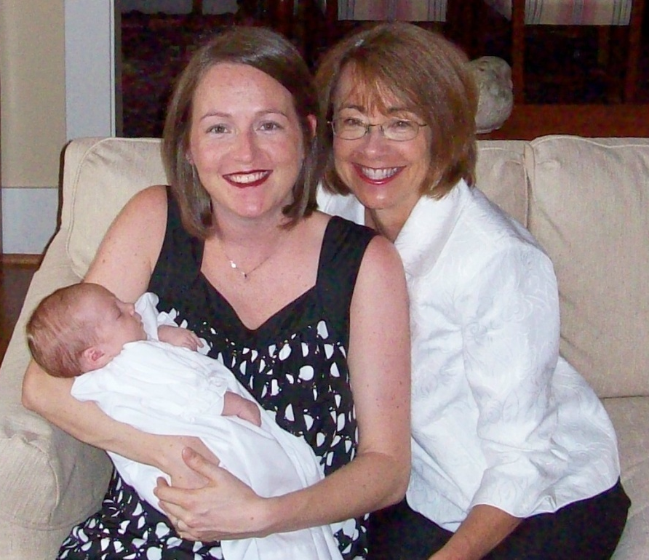
Summary
In almost every case breastfeeding should be encouraged
Refer the mother to the WIC Designated Breastfeeding Expert if you are unsure

Slide 28

Application To Practice: Overcoming Barriers
Handout 4.2: “Resources”
Handout 4.3: “Application To Practice: Overcoming Barriers”

Slide 29

Grow Your Breastfeeding Skills
“My Goals for Breastfeeding Support”
Goal-Setting Flower

